Slide 1


NETWORK PROTOCOLS & security
24EC2210
Topic:
DATALINK LAYER PROTOCOLS
Session – 10

Slide 2

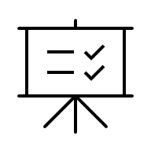

AIM OF THE SESSION
To familiarize students with the basic idea of Datalink layer protocols
INSTRUCTIONAL OBJECTIVES
This Session is designed to:
Demonstrate the need for datalink layer protocols
Describe the datalink control protocols for noiseless channels
Describe the datalink control protocols for noisy channels.
LEARNING OUTCOMES
At the end of this session, you should be able to:
Illustrate the need for datalink control protocols
Understand the working of datalink protocols for noiseless channels
Understand the working of datalink protocols for noisy channels

Slide 3
SESSION INTRODUCTION
The most important responsibilities of the data link layer are flow control and error control. Collectively, these functions are known as data link control.
Flow control refers to a set of procedures used to restrict the amount of data that the sender can send before waiting for acknowledgment.
Error control in the data link layer is based on automatic repeat request, which is the retransmission of data.

Slide 4
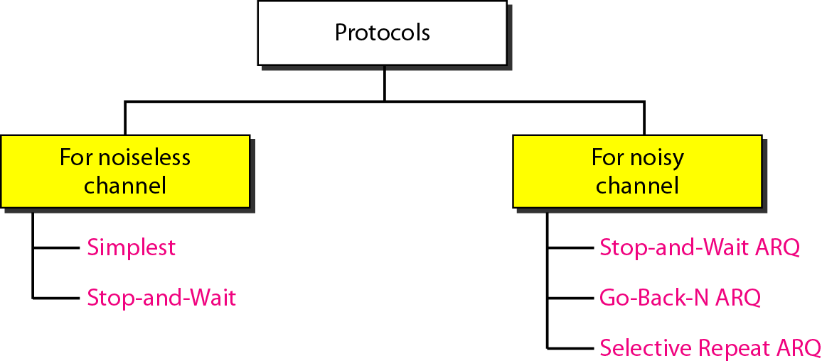
DATA LINK LAYER PROTOCOLS
The data link layer can combine framing, flow control, and error control to achieve the delivery of data from one node to another.
The protocols are normally implemented in software by using one of the common programming languages.

Slide 5
DLL PROTOCOLS FOR NOISELESS CHANNELS
Noiseless channel is an ideal channel in which no frames are lost, duplicated, or corrupted.
Two protocols for this type of channel.
Simplest Protocol
Stop-and-wait Protocol

Slide 6
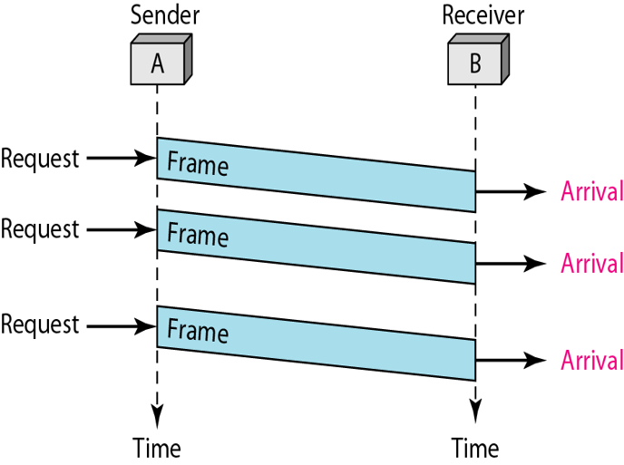
Simplest Protocol
Protocol with no flow or error control.
It is very simple.
The sender sends a sequence of frames without even thinking about the receiver.

Slide 7
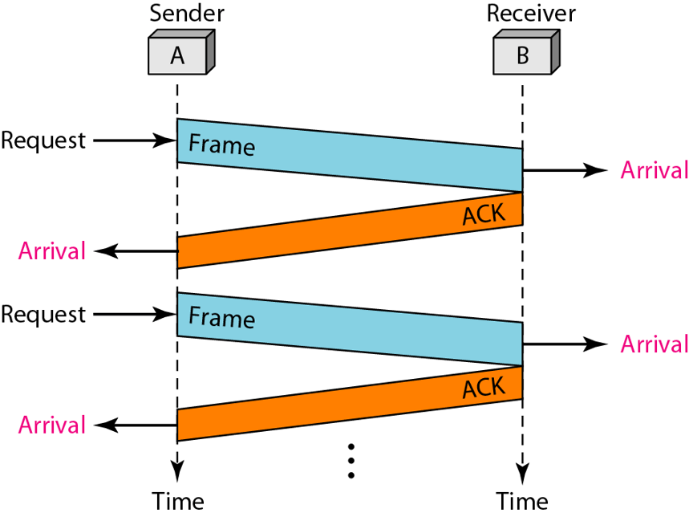
Stop-and-wait Protocol
Protocol with flow control.
The sender will not transmit the next frame until it receives the acknowledgement of the last transmitted frame.

Slide 8
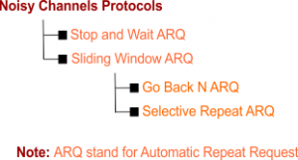
DLL PROTOCOLS FOR NOISY CHANNELS
Although the Stop-and-Wait Protocol gives us an idea of how to add flow control, noiseless channels are nonexistent.
Uses Sliding window protocols.
Follows Automatic Repeat Request (ARQ).
Adds Flow control and Error Control.

Slide 9
1. Stop-and-wait ARQ
Stop-and-wait ARQ is a technique used to retransmit the data in case of damaged or lost frames.
This technique works on the principle that the sender will not transmit the next frame until it receives the acknowledgement of the last transmitted frame.

Slide 10
1. Stop-and-wait ARQ…
Four features are required for the retransmission:
The sending device keeps a copy of the last transmitted frame until the acknowledgement is received. Keeping the copy allows the sender to retransmit the data if the frame is not received correctly.
Both the data frames and the ACK frames are numbered alternately 0 and 1 so that they can be identified individually. Suppose data 1 frame acknowledges the data 0 frame means that the data 0 frame has been arrived correctly and expects to receive data 1 frame.
If an error occurs in the last transmitted frame, then the receiver sends the NAK frame which is not numbered. On receiving the NAK frame, sender retransmits the data.
It works with the timer. If the acknowledgement is not received within the allotted time, then the sender assumes that the frame is lost during the transmission, so it will retransmit the frame.

Slide 11
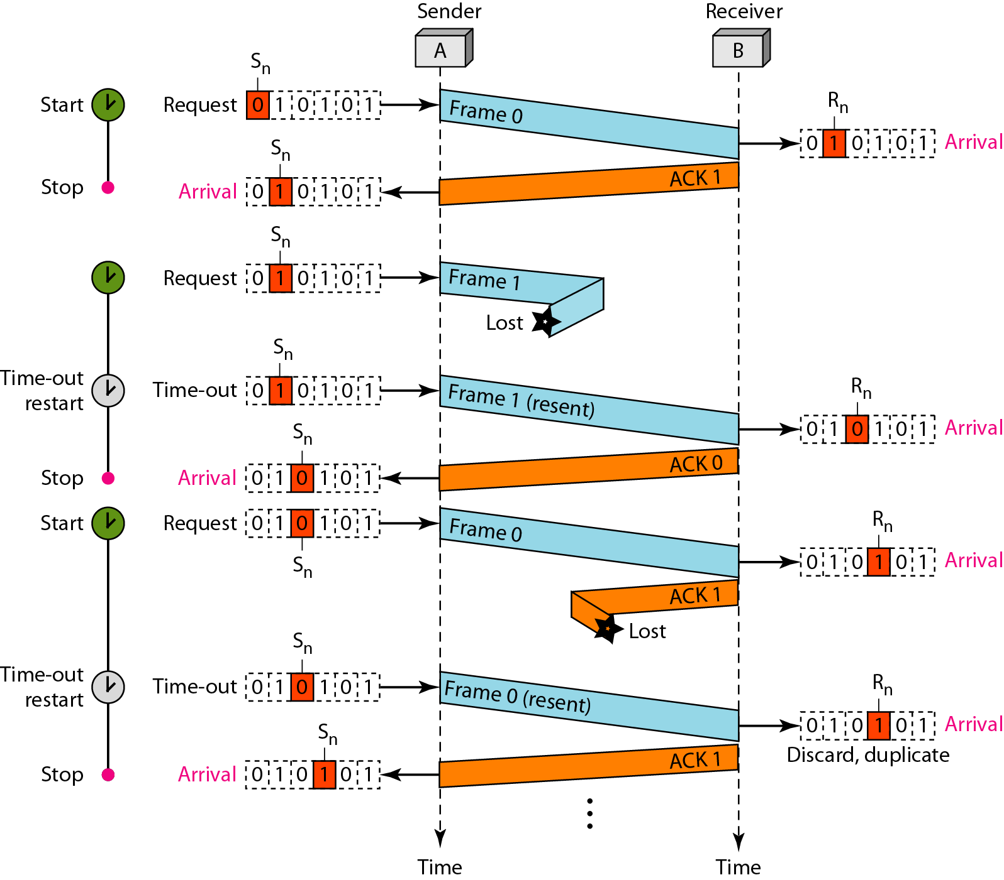
1. Stop-and-wait ARQ…
Possibilities of the retransmission:
Lost frame
Damaged Frame
Lost ACK

Slide 12
1. Stop-and-wait ARQ…
Advantage of Stop-and-wait:
The Stop-and-wait method is simple as each frame is checked and acknowledged before the next frame is sent.
Disadvantage of Stop-and-wait:
Stop-and-wait technique is inefficient to use as each frame must travel across all the way to the receiver, and an acknowledgement travels all the way before the next frame is sent. Each frame sent and received uses the entire time needed to traverse the link.

Slide 13
SLIDING WINDOW
The Sliding Window is a method of flow control in which a sender can transmit the several frames before getting an acknowledgement.
Multiple frames can be sent one after the another due to which capacity of the communication channel can be utilized efficiently.
A single ACK acknowledge multiple frames.
Sliding Window refers to imaginary boxes at both the sender and receiver end.
The window can hold the frames at either end, and it provides the upper limit on the number of frames that can be transmitted before the acknowledgement.
The window has a specific size in which they are numbered as modulo-n means that they are numbered from 0 to n-1. For example, if n = 8, the frames are numbered from 0,1,2,3,4,5,6,7,0,1,2,3,4,5,6,7,0,1........
When the receiver sends the ACK, it includes the number of the next frame that it wants to receive. For example, to acknowledge the string of frames ending with frame number 4, the receiver will send the ACK containing the number 5. When the sender sees the ACK with the number 5, it got to know that the frames from 0 through 4 have been received.

Slide 14
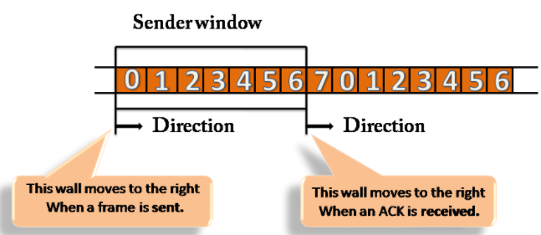
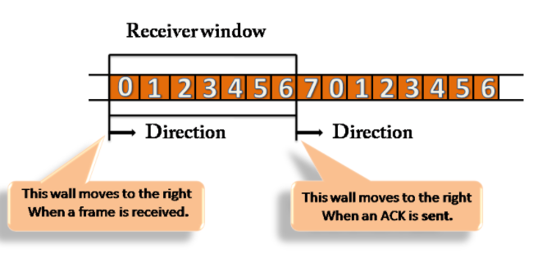
Sliding Window…

Slide 15
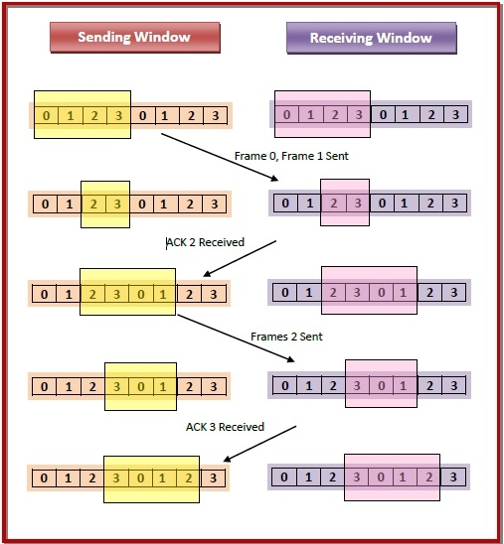
Sliding Window…

Slide 16
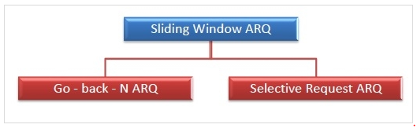
SLIDING WINDOW PROTOCOLS
Sliding Window ARQ is a technique used for continuous transmission error control.
Two protocols used in sliding window ARQ.

Slide 17
Sliding Window Protocols…
Three Features used for retransmission:
In this case, the sender keeps the copies of all the transmitted frames until they have been acknowledged. Suppose the frames from 0 through 4 have been transmitted, and the last acknowledgement was for frame 2, the sender has to keep the copies of frames 3 and 4 until they receive correctly.
The receiver can send either NAK or ACK depending on the conditions. The NAK frame tells the sender that the data have been received damaged. Since the sliding window is a continuous transmission mechanism, both ACK and NAK must be numbered for the identification of a frame. The ACK frame consists of a number that represents the next frame which the receiver expects to receive. The NAK frame consists of a number that represents the damaged frame.
The sliding window ARQ is equipped with the timer to handle the lost acknowledgements. Suppose then n-1 frames have been sent before receiving any acknowledgement. The sender waits for the acknowledgement, so it starts the timer and waits before sending any more. If the allotted time runs out, the sender retransmits one or all the frames depending upon the protocol used.

Slide 18
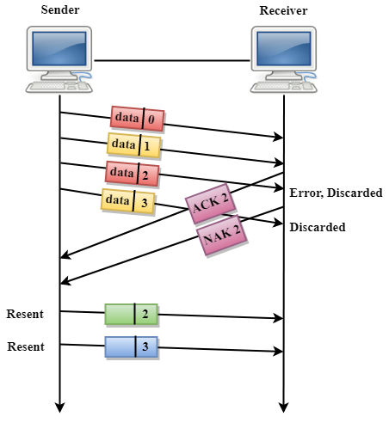
2. Go-Back-N ARQ
In Go-Back-N ARQ protocol, if one frame is lost or damaged, then it retransmits all the frames after which it does not receive the positive ACK.

Slide 19
2. Go-Back-N ARQ…
Three possibilities can occur for retransmission:
Damaged Frame: When the frame is damaged, then the receiver sends a NAK frame. Then sender retransmits all the frames from the damaged frame.
Lost Data Frame: In Sliding window protocols, data frames are sent sequentially. If any of the frames is lost, then the next frame arrive at the receiver is out of sequence. The receiver checks the sequence number of each of the frame, discovers the frame that has been skipped, and returns the NAK for the missing frame. The sending device retransmits the frame indicated by NAK as well as the frames transmitted after the lost frame.
Lost Acknowledgement: The sender can send as many frames as the windows allow before waiting for any acknowledgement. Once the limit of the window is reached, the sender has no more frames to send; it must wait for the acknowledgement. If the acknowledgement is lost, then the sender could wait forever. To avoid such situation, the sender is equipped with the timer that starts counting whenever the window capacity is reached. If the acknowledgement has not been received within the time limit, then the sender retransmits the frame since the last ACK.

Slide 20
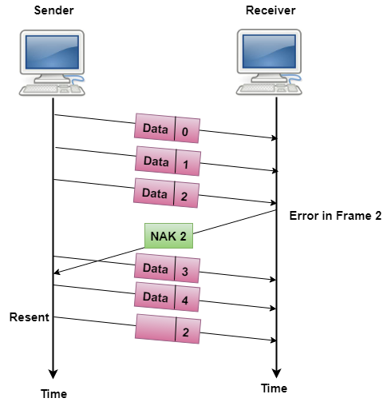
3. Selective Repeat ARQ
Selective-Reject ARQ technique is more efficient than Go-Back-n ARQ.
In this technique, only those frames are retransmitted for which negative acknowledgement (NAK) has been received.
The receiver storage buffer keeps all the damaged frames on hold until the frame in error is correctly received.
The receiver must have an appropriate logic for reinserting the frames in a correct order.
The sender must consist of a searching mechanism that selects only the requested frame for retransmission.

Slide 21

SUMMARY
Datalink Layer Protocols
DLL Protocols for Noiseless Channels
DLL Protocols for Noisy Channel
DLL Protocols for Noiseless Channels
Simplest
Stop-and-wait
DLL Protocols for Noisy Channels
Stop-and-wait ARQ
Go-back-N ARQ
Selective Repeat ARQ

Slide 22
TERMINAL QUESTIONS
1. Describe the DLL protocols for Noiseless Channels.
2. Describe the DLL protocols for Noisy Channels

Slide 23
REFERENCES FOR FURTHER LEARNING OF THE SESSION
Reference Books:
Behrouz A. Forouzan , “Data Communication and Networking”, TMH, 5th Edition, 2012.
A.S. Tanenbaum, David J. Wetheral “Computer Networks” Pearson, 5th Edition.

Slide 24
THANK YOU
Team – Network Protocols & Security

